Slide 1



Denver Dev Day
October 19th, 2018
Thanks to our sponsors!

Slide 2
C# In The Browser
Write Blazin’ Web Apps with Blazor

Slide 3




Eric Montgomery
Visibility – Application Architect
https://github.com/ermontgo/BlazorWeather

Slide 4


.Net in the Wild





Slide 5
.Net in the Wild

Server
Windows Service
Console App
ASP.NET
.Net Core




Slide 6
.Net in the Wild

Desktop
WinForms
WPF
UWP




Slide 7
.Net in the Wild

Mobile
Xamarin




Slide 8
.Net in the Wild

IoT
Windows 10 IoT
.Net Core




Slide 9
.Net in the Wild

Wearables
Hololens
Xamarin




Slide 10
.Net in the Wild

Living Room
Xbox One & UWP




Slide 11
.Net in the Wild

Browser
?




Slide 12
Surfin’ the Web
Browser
Land of the SPA (Single-Page Application)
Twitter
Gmail
Trello
JavaScript is the lingua franca

Slide 13
Changing the Equation
Blazor
Client-side SPA framework
Built on top of Mono and WASM
Executes .Net in the browser

Slide 14
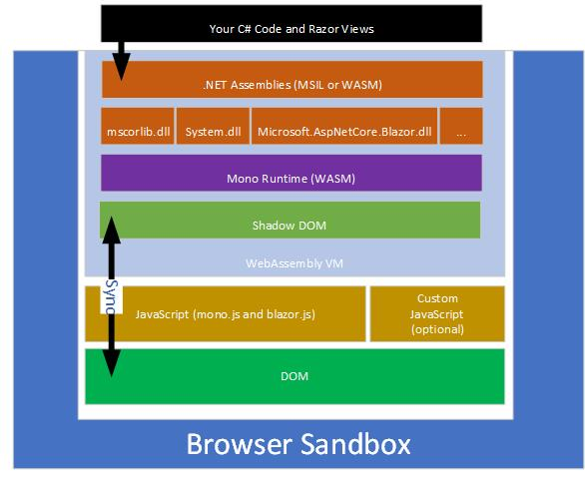
Blazin’ Architecture
CC BY-ND – Dr. Holger Schwichtenberg (www.IT-Visions.de)

Slide 15
What’s Good?
Mature, Robust Language
Static Analysis
MSBuild
LINQ
Ease of Setup
Reuse

Slide 16
Danger, Will Robinson!
Experimental!
Don’t Use in Production
Roadmap focused on hard problems
“May not” be picked up as a product
Did I say don’t use in production?

Slide 17
Resources
Blazor Web Site - https://blazor.net/
Learn Blazor - https://learn-blazor.com/
Blazor Github - https://github.com/aspnet/Blazor
Slides and Code – https://github.com/ermontgo/BlazorWeather

Slide 18
Eric Montgomery
Visibility – Application Architect
https://github.com/ermontgo/BlazorWeather

